Slide 1
Different General Methods in Algorithms Design
By: Iman Khani Jazani
AI and Data Specialist, Business Developer | AiHum
Adjunct Professor | Sharif University of Technology
Senior Data Scientist, Community builder | Adin

Slide 2
Last Lecture
Short Presentations
Big picture about methods in algorithms design
Recursive methods in algorithms
Application of Programming in the Digital Age!

Slide 3
Today
Short Presentations
Review the last lecture
Searching and sorting applications
Introduction to searching and sorting algorithms
Application of Programming in the Digital Age!

Slide 4
Together
Send your feedback about the class whenever you want!

Slide 5

Contact me
Gmail: ImanKhaniJazani@gmail.com
LinkedIn: https://www.linkedin.com/in/ImanKhaniJazani/
Telegram: @IKJ1992

Slide 6
Short Presentations

Slide 7
Review the Last Lecture

Slide 8
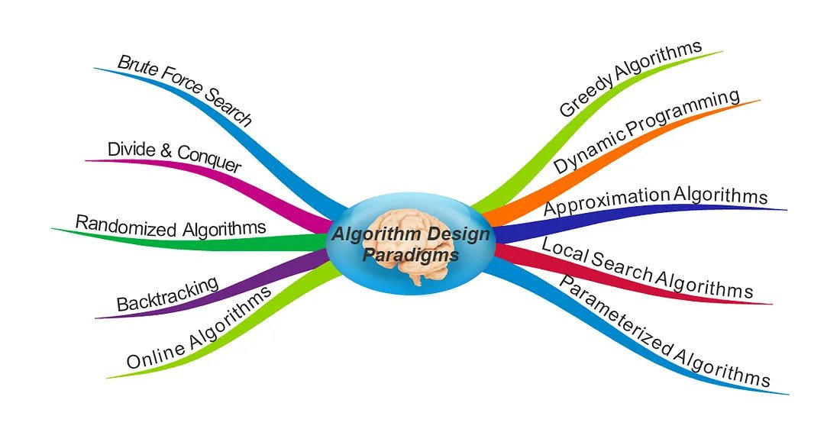
Algorithm design paradigms

Slide 9
Recursive mindset
We use, as humans, recursive methods in our life. When we want to ready for exam, Think about it…
What is your idea about example in real life?
Backtrack
Solve the base
Divide many times

Slide 10
3 attitudes?
Mathematical formula
Iterative approach
Formal recursive
Others??

Slide 11
Searching and Sorting Applications

Slide 12
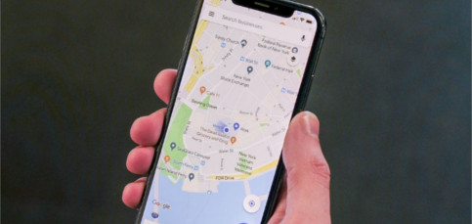
Maps

Slide 13
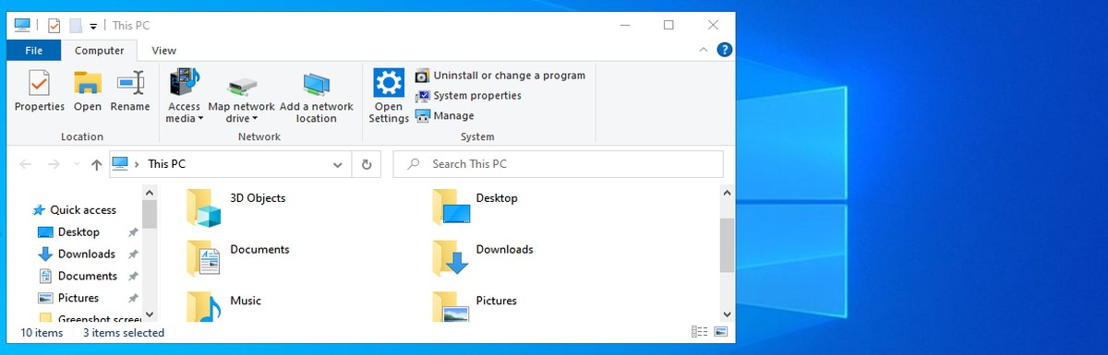
Windows file explorer

Slide 14
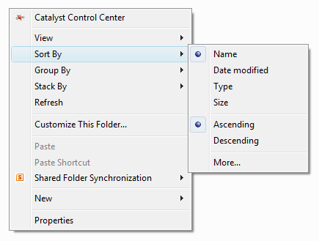
Sort By in Windows

Slide 15

Library: sort and search

Slide 16
Other Applications?🤨

Slide 17
Introduction to searching and sorting algorithms

Slide 18
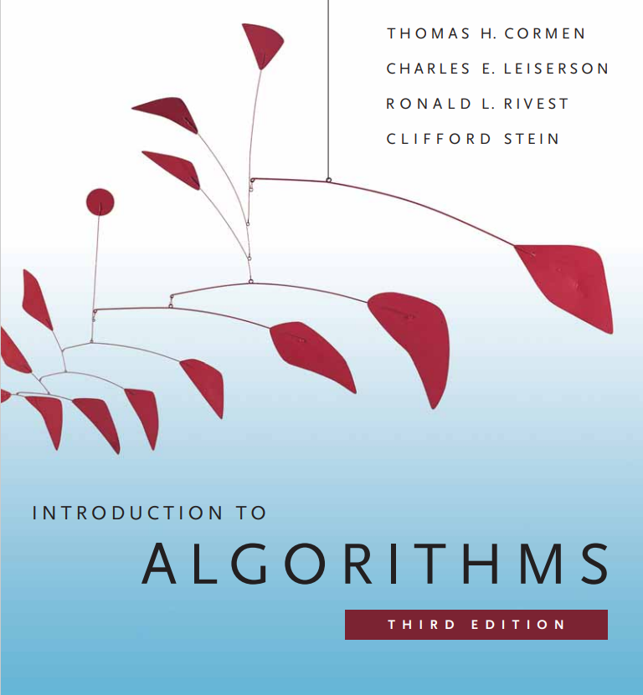
Short Presentation
Foundation chapter presentation

Slide 19
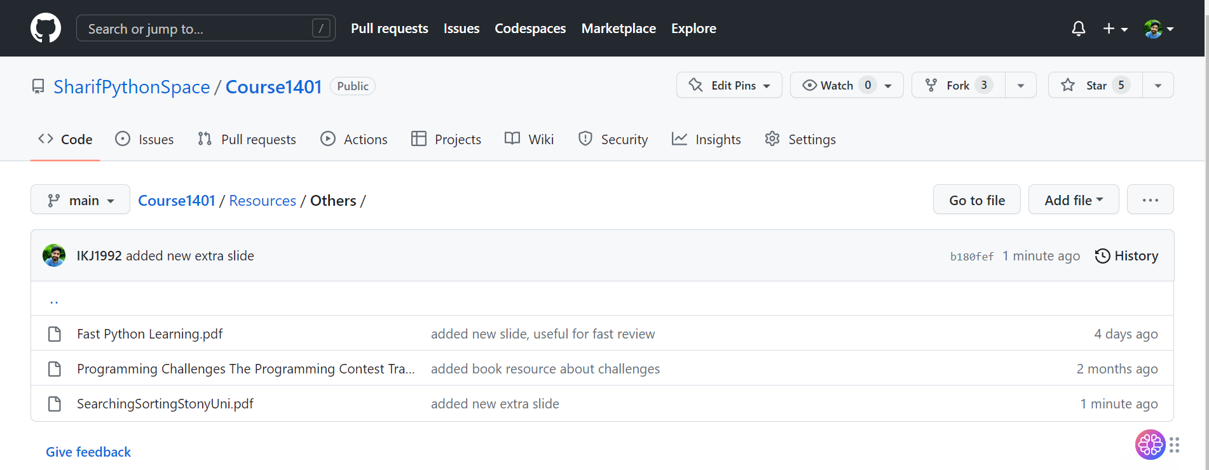
Let’s read it with each other!

Slide 20
Application of Programming in the Digital Age!

Slide 21
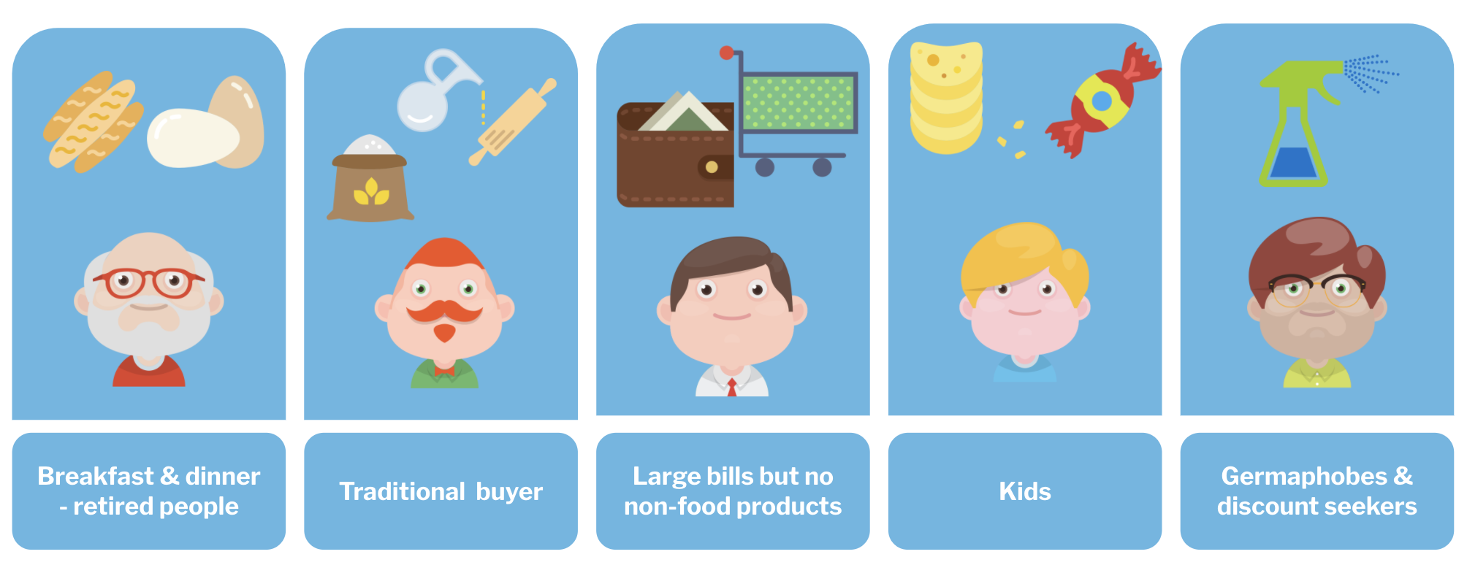
Your mid-term project: Recommender System

Slide 22
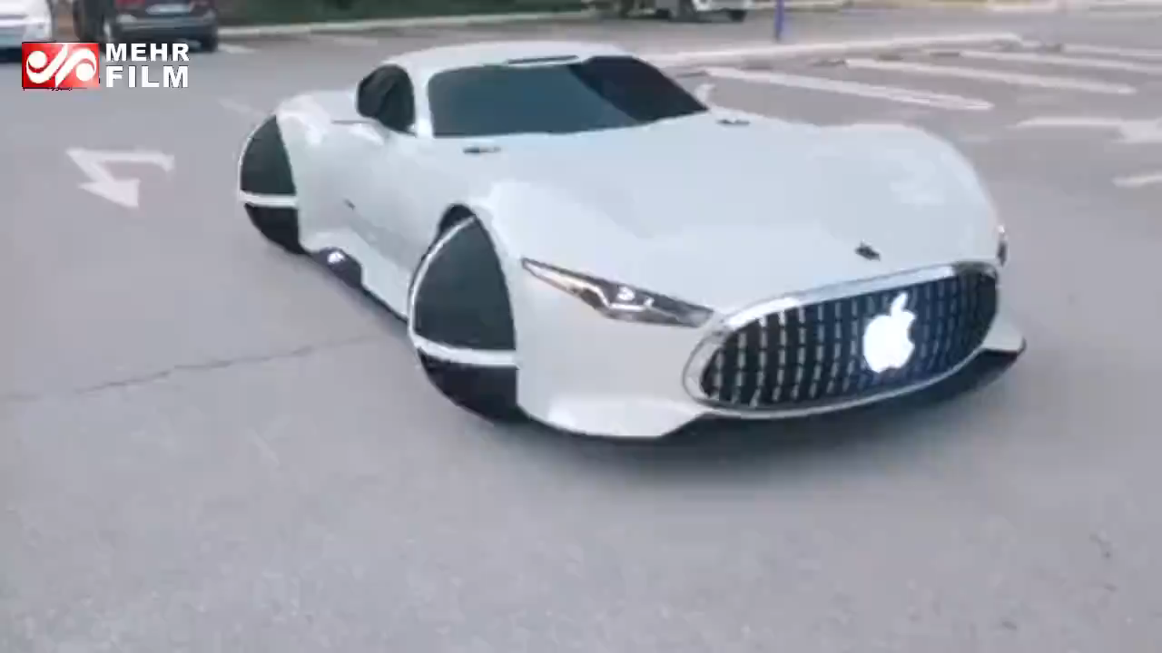
چرخ هم میتواند دوباره اختراع شود!

Slide 23
Lecture Resources
https://www.geeksforgeeks.org/difference-between-searching-and-sorting-algorithms/
https://www.geeksforgeeks.org/searching-algorithms/
https://realpython.com/build-recommendation-engine-collaborative-filtering/

